Slide 1

Project Progress-2 Review Presentation & Demonstration on “FoodFinder : A restaurant recommender system”
Students:
Varsha Ravindra (1RN115CS119)
Sunidhi Hegde (1RN15CS110)
Guide:
Dr. Shashidhara H R
Asst. Prof. Dept. of CSE, RNSIT
Department of Computer Science and Engineering
RNS INSTITUTE OF TECHNOLOGY
2018-19

Slide 2
CONTENTS
INTRODUCTION
Problem Statement
Existing System and Limitations
Proposed system
REQUIREMENTS
Functional Requirements
Non-functional Requirements
Hardware & Software Requirements
SYSTEM ARCHITECTURE/BLOCK DIAGRAM
System architecture
DETAILED DESIGN (Module wise)
Modules implemented
Libraries used / API’s
IMPLEMENTATIONS (Module wise)
Algorithm/Methods/Pseudo code
RESULT ANALYSIS
Snapshots
CONCLUSION
Conclusion
Future work to be carried out
REFERENCES

Slide 3
INTRODUCTION
Problem Statement
Providing related content out of relevant and irrelevant collection of items to users of online service providers.
Restaurant recommender system aims to recommend restaurants to users based on user-restaurant ratings, reviews, price and location

Slide 4
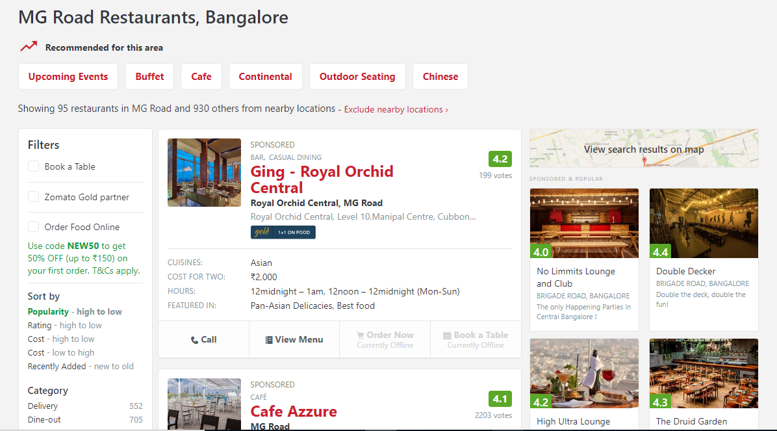
Existing system and it’s limitations
Does not take user interest into account
Neglects the influence of different rating standards
Less accountable result

Slide 5
Proposed system
A restaurant recommender system which uses collaborative filtering to provide recommendations based on ratings provided by other similar users and the browsing history of the current user.
Advantages
Higher algorithm performance
More accurate results

Slide 6
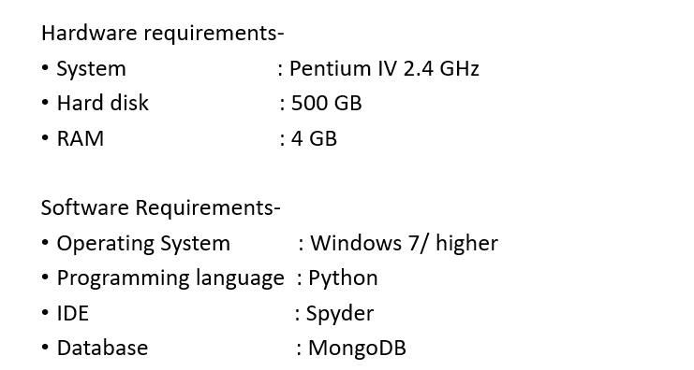
REQUIREMENTS
Hardware and Software Requirements:

Slide 7
Functional Requirements:
Take user input and provide recommendations accordingly.
If the user has previously ordered using the application, recommendations are provided based on the order history.
Non-Functional Requirements:
Improved accuracy.
Improved performance.

Slide 8
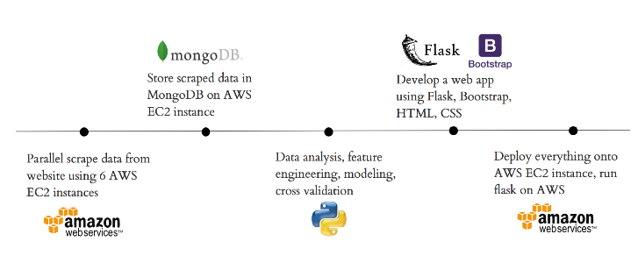
SYSTEM ARCHITECTURE

Slide 9
DETAILED DESIGN
Modules implemented:
Designed a scraper to scrape Zomato website.
Flask is being used as a Web Server Gateway Interface.
HTML, CSS and Bootstrap have been used to design the front-end.
Front-end code has been integrated with Python using Flask.
Successful establishment of connection with MongoDB.

Slide 10
Libraries Used:
Flask - Flask is a lightweight WSGI web application framework. It is designed to make getting started quick and easy, with the ability to scale up to complex applications. It is one of the most popular Python web application frameworks.
PyMongo - It is a Python distribution containing tools for working with MongoDB, and is the recommended way to work with MongoDB from Python.
BeautifulSoup - Beautiful Soup is a Python library for pulling data out of HTML and XML files. It works with a parser to provide idiomatic ways of navigating, searching, and modifying the parse tree.

Slide 11
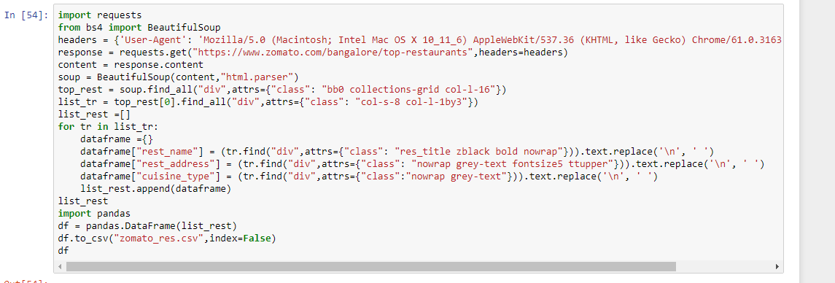
IMPLEMENTATION (Module wise)
Web Scraper Code and Output:

Slide 12
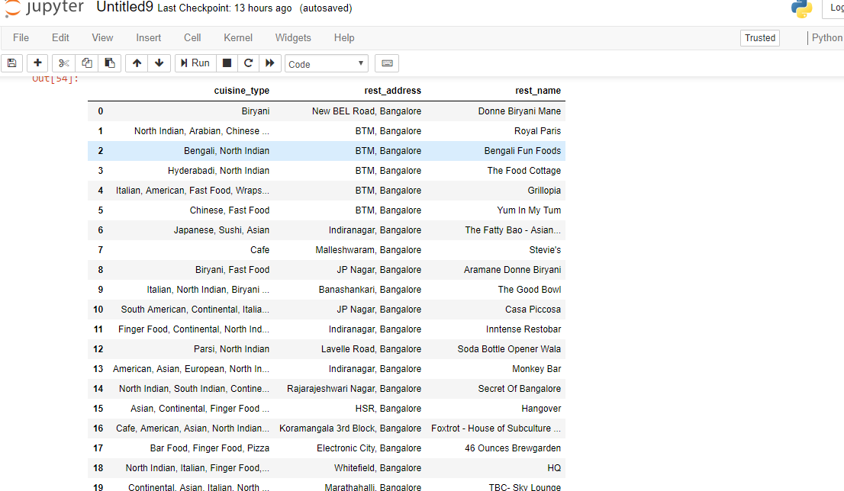

Slide 13
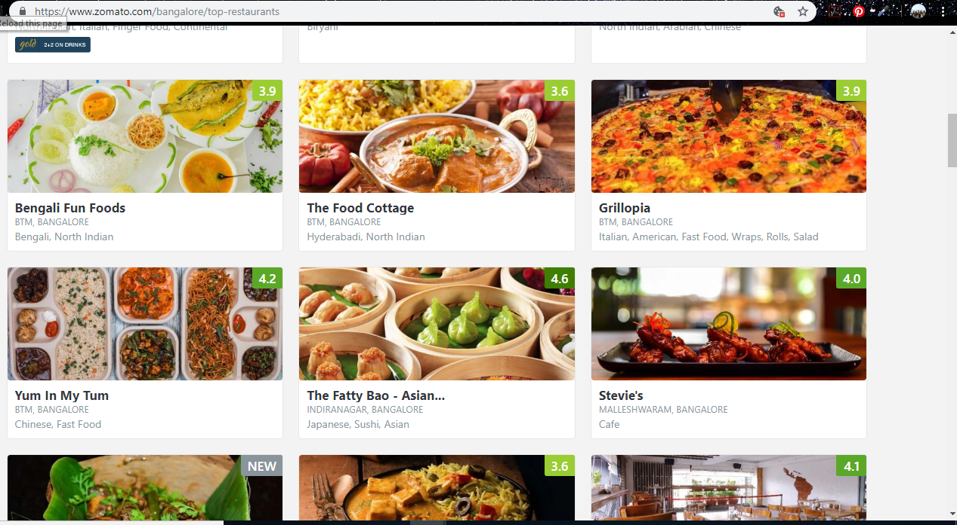
Web page used to scrape data:

Slide 14
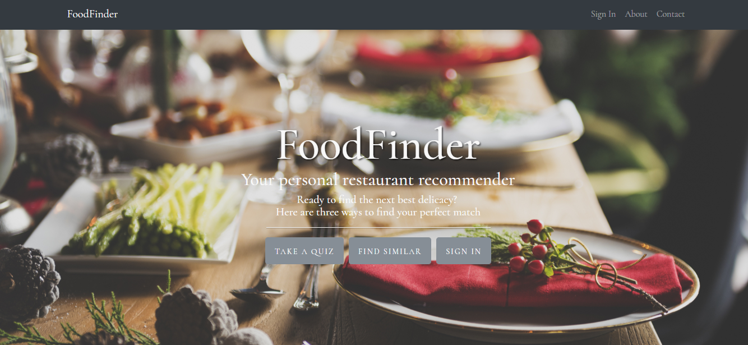
RESULT

Slide 15
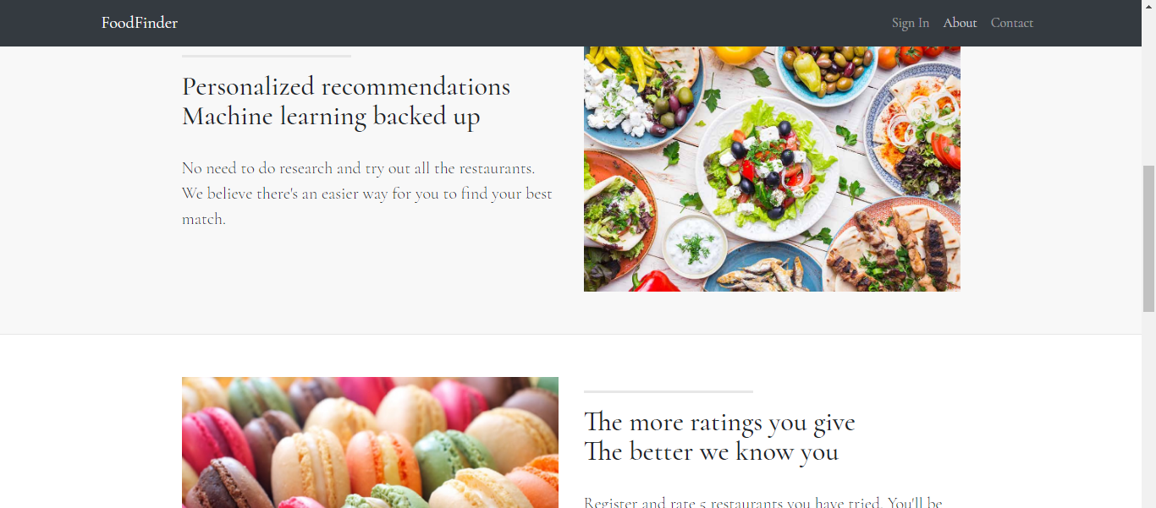

Slide 16
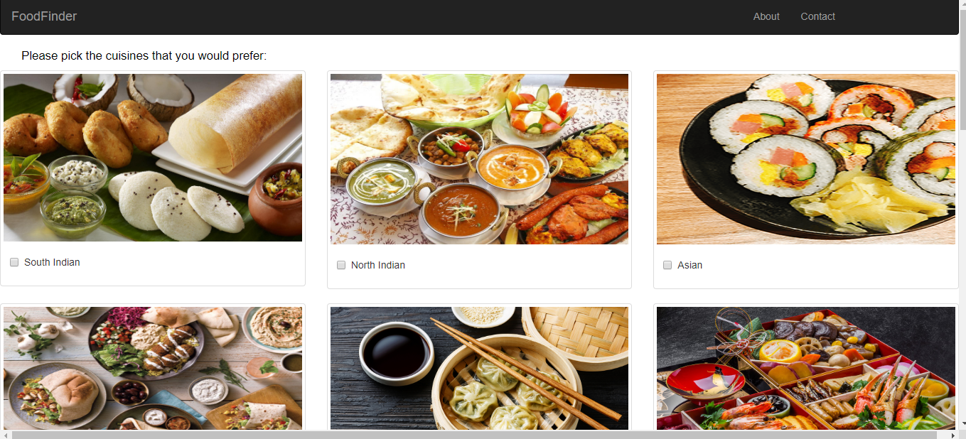

Slide 17
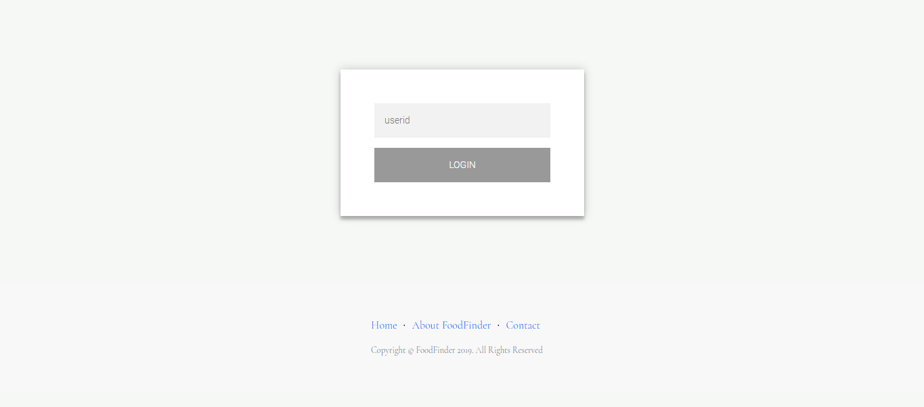

Slide 18
CONCLUSION
Existing system limitations
Does not take user interest into account
Neglects the influence of different rating standards
Less accountable result
Proposed System Advantages
Higher algorithm performance
More accurate results

Slide 19
Future work to be carried out
Current status of the project completion (%) : 40%
Work to be carried out :
Clean and get the scraped data ready.
Implement the algorithms on the dataset obtained.
Connect the front-end with the back-end.

Slide 20
REFERENCES
[1] Hybrid recommender systems: Survey and experiments, User-modelling and User-adapted interactions , November 2002
[2] https://www.sciencedirect.com/science/article/pii/S1110866515000341
[3] https://www.datacamp.com/community/tutorials/recommender-systems-python
[4] https://en.wikipedia.org/wiki/Recommender_system
[5] https://www.marutitech.com/recommendation-engine-benefits/
[6] https://towardsdatascience.com/my-journey-to-building-book-recommendation-system-5ec959c41847

Slide 21

PROJECT SETUP AND DEMONSTRATION

Slide 22
Suggestions….!

Slide 23
THANK YOU!!!

